Slide 1

E-Buy Online Shopping
Team 2
Shirish Srinivasa
Kavya Raviprakash
Luke Henkenius
Akhila Pillalamarri

Slide 2
Team Members and Roles
Kavya Raviprakash – Project Manager / Developer
Shirish Srinivasa – Developer / Tester
Luke Henkenius – Developer / Tester
Akhila Pillalamarri - Scrum master / Developer

Slide 3
Index
Web Application Purpose
Data Model
Team accomplishments during Sprint 2
Features completed
Application Screen shots
APIs Implemented
Lessons learned
Release Plan and Stand-Up notes
GitHub and Trello Board, Test case and Test scripts video Links
Login Credentials, application link and Technical Manual
Payment Details to be entered

Slide 4
Web Application Purpose
Ecommerce or electronic commerce refers to a business model that involves sales transactions being done on the web. Virtually every online shopping website - big or small - follows this structure. Any site where you can obtain items for sale over the internet is considered an ecommerce website.
The purpose for designing this ecommerce (shopping-cart) application is because most of the people nowadays prefer shopping online rather than spending a lot of time at physical markets. It basically saves the shoppers time, and they can easily browse through hundreds of products from the place of their convenience.
Through the use of an ecommerce application, a retailer can sell his products to customers who might be living at distant places and a customer can easily browse through products, can also compare their prices and can buy the products that would suit their need.
This web application will be built using the python and Django Framework integrated with various APIs to improve the web application’s functionality.

Slide 5
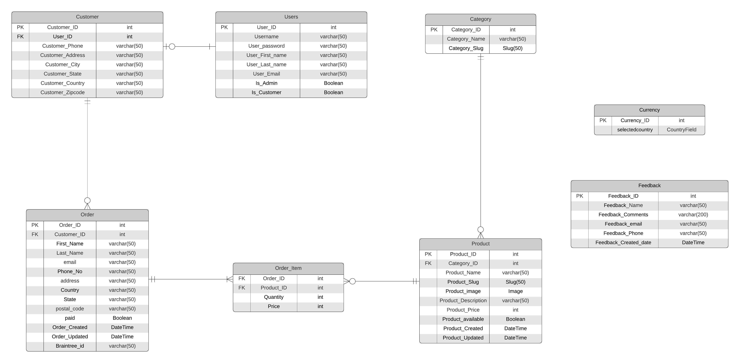
Data Model

Slide 6
Team accomplishments during Sprint 2
Understand the Working of APIs
Successfully implemented the email API for sending email
Successfully implemented the Twilio API for sending SMS notification
Successfully implemented the language translation API-Rosetta
Successfully implemented the Currency API
Successfully implemented the Braintree API for making payments

Slide 7
Features completed
Review order details
Download order invoice
Web app language translation
Implemented payment gateway
Implemented email API
Implemented SMS notification API
Implemented currency conversion API

Slide 8
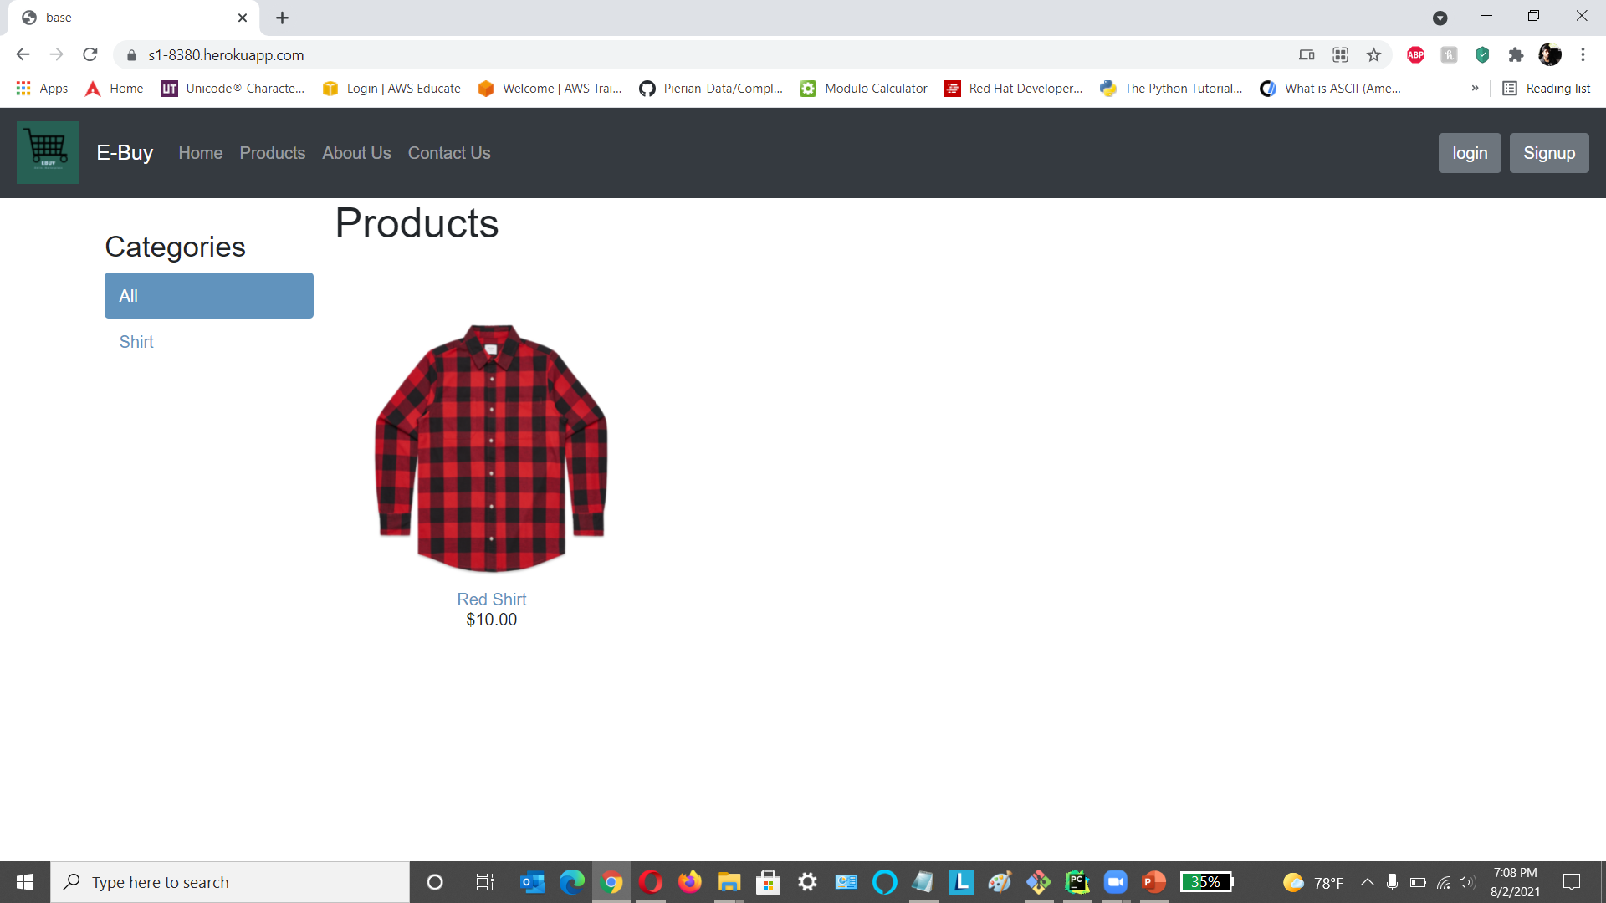
Application Screen shots Home page

Slide 9
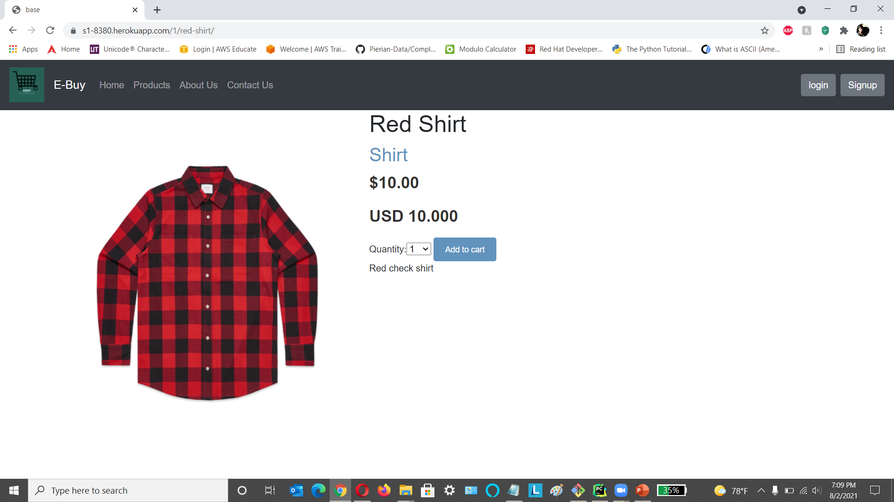
Product Description page

Slide 10
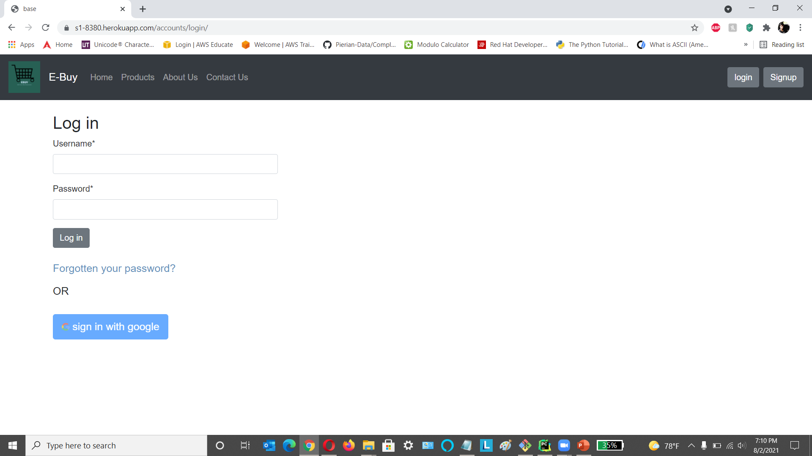
Login page

Slide 11
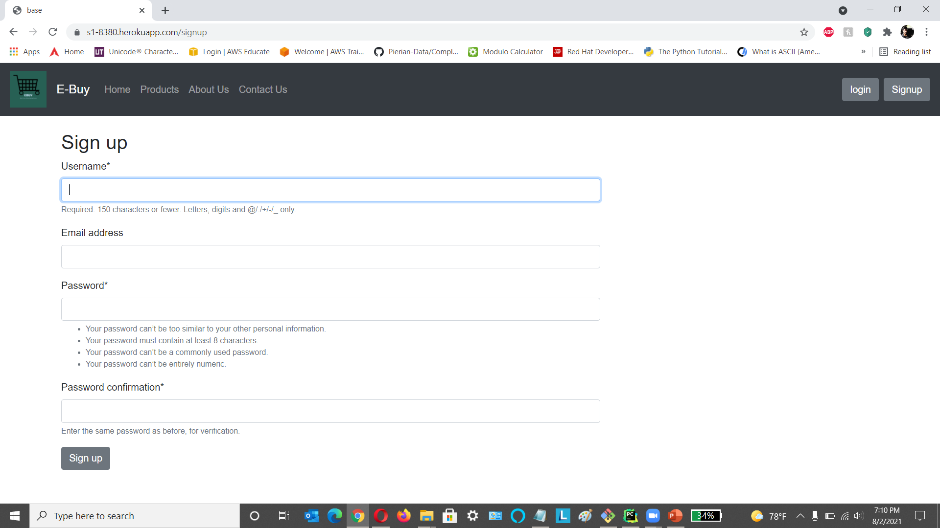
Signup page

Slide 12
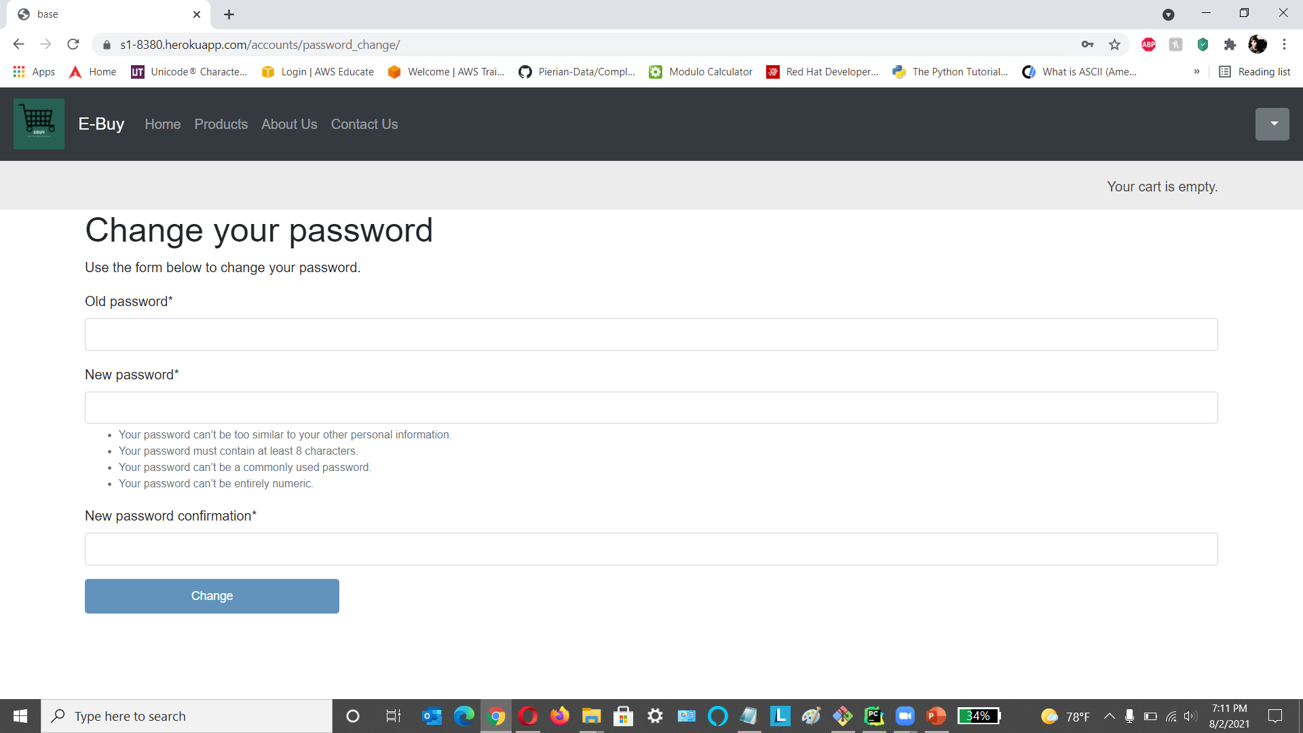
Change Password Page

Slide 13
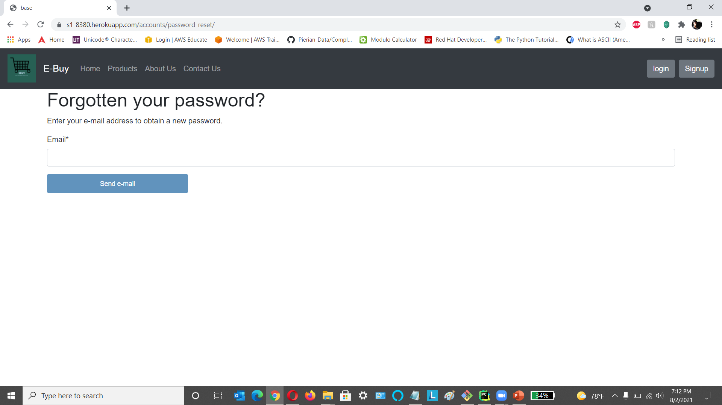
Forgot Password Page

Slide 14
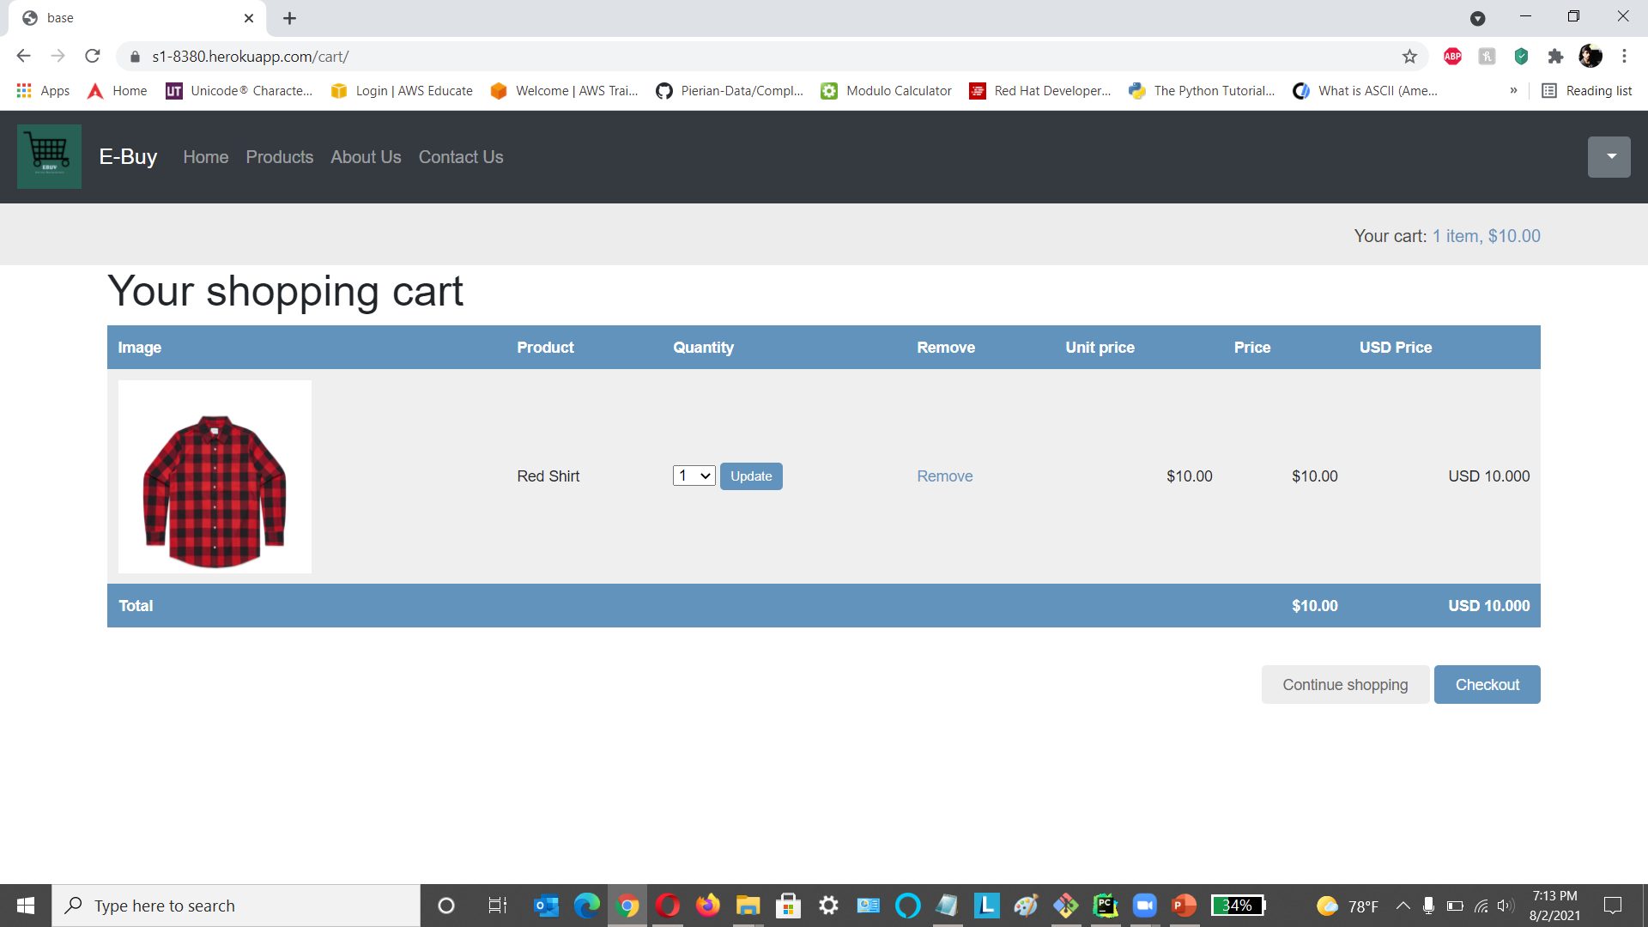
Cart Page

Slide 15
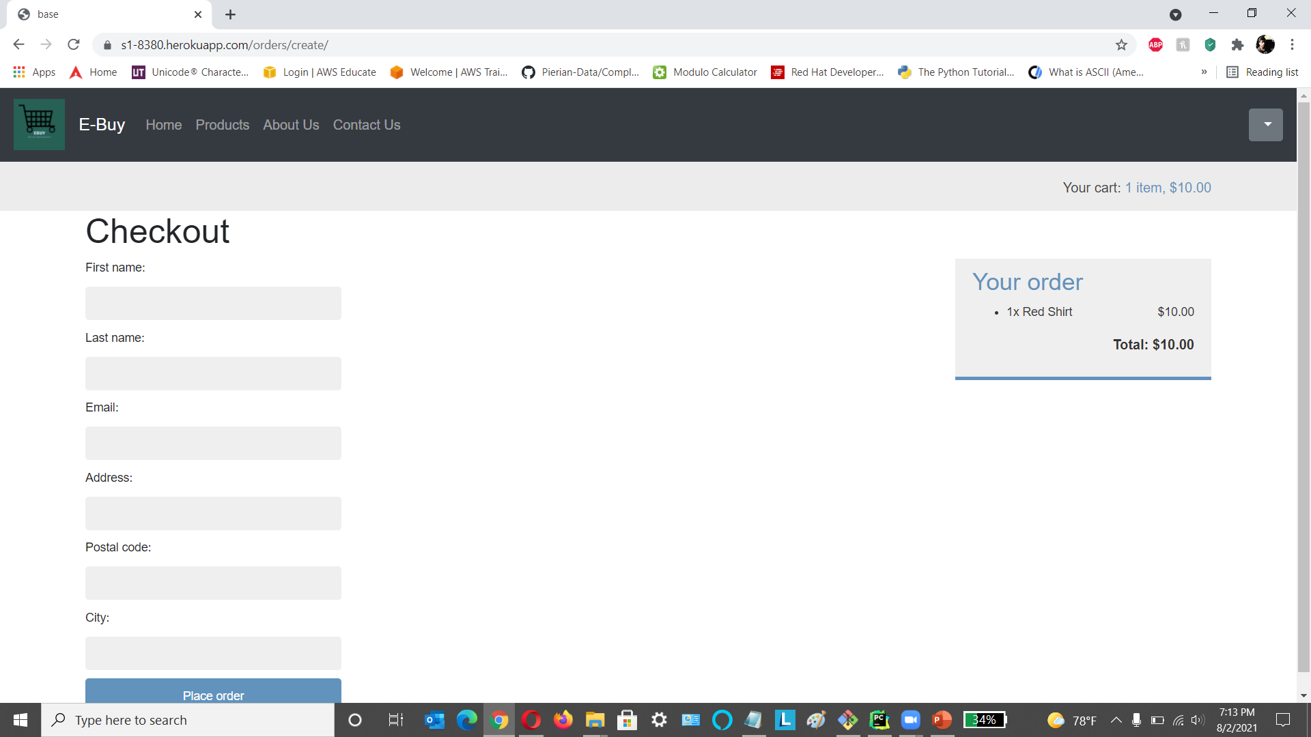
Checkout Page

Slide 16
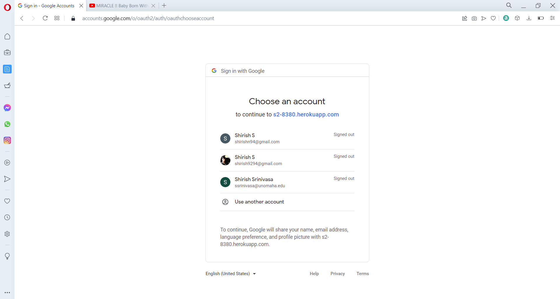
Customer Signup with Google API

Slide 17
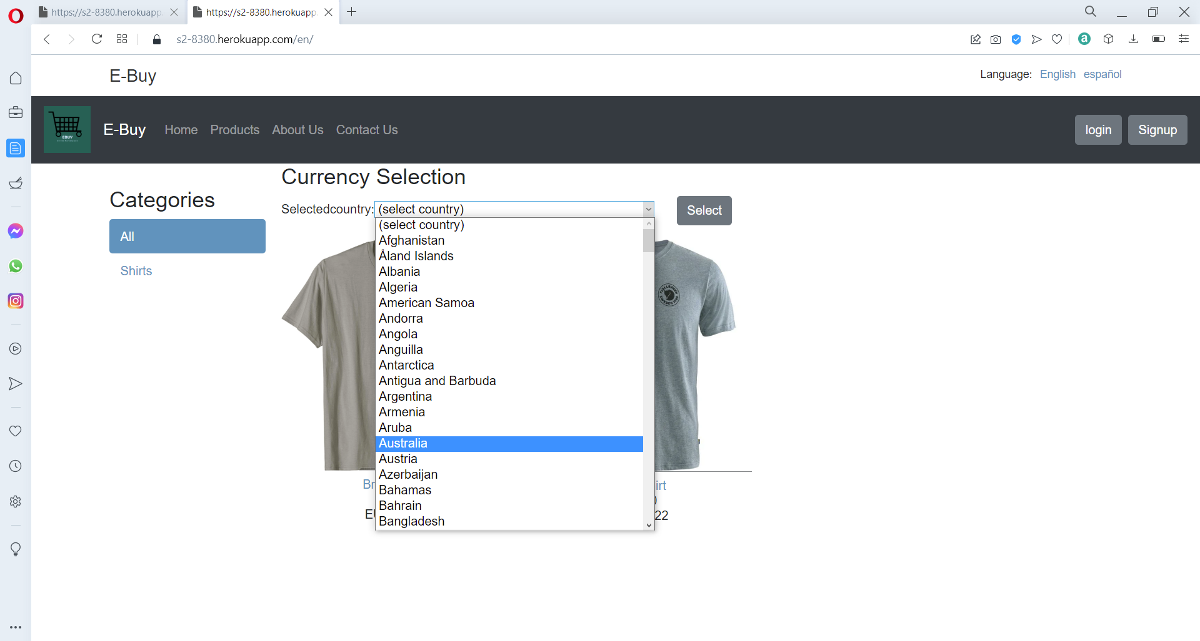
Currency Conversion

Slide 18
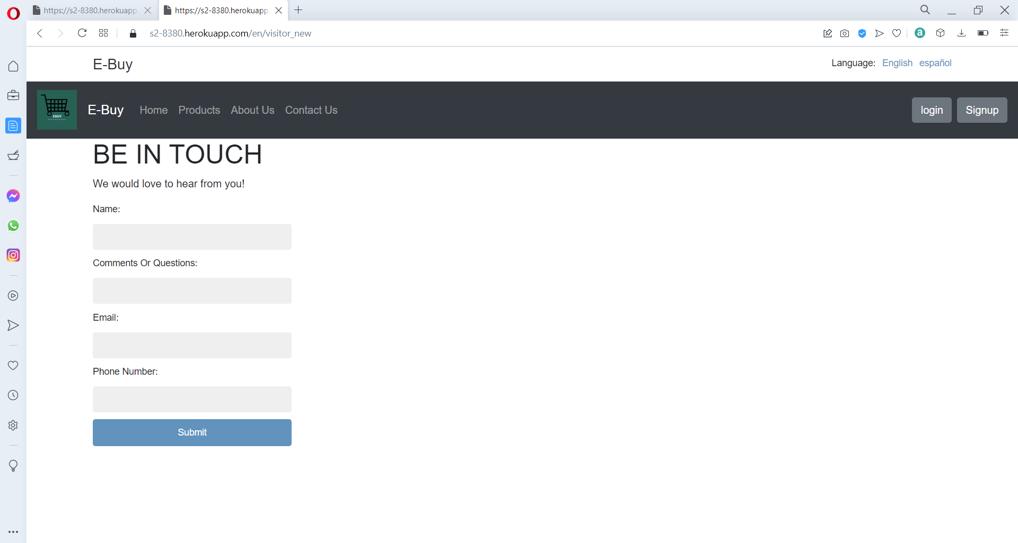
Contact Us Page

Slide 19
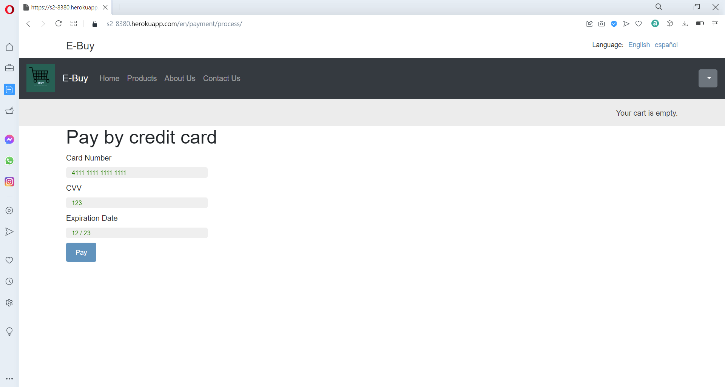
Payment Page

Slide 20
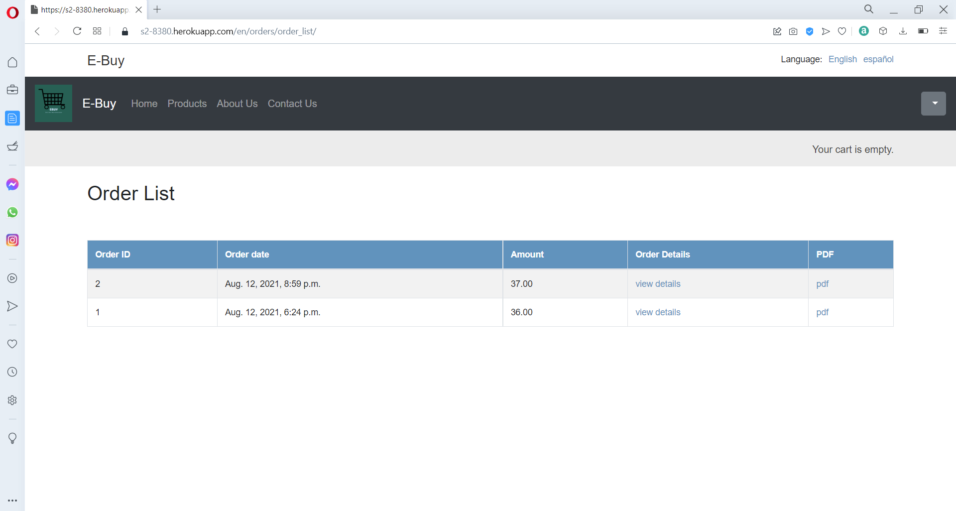
My Orders Page

Slide 21
APIs Implemented
Google Sign-in API:
In this Ecommerce application we are going to provide new users to authenticate and sign up for the application by integrating the google sign-in to our application.
https://developers.google.com/identity/sign-in/web/sign-in
Geo currency API:
This API will be used for currency conversion for the products in the ecommerce website.
https://currency.getgeoapi.com/documentation/
Rosetta API:
This API will be used for language translation
https://django-rosetta.readthedocs.io

Slide 22
APIs Implemented
SendGrid API:
In this Ecommerce application, we are going to send email notification to the users on the orders that were successfully placed, and the mail would also contain a pdf copy which would contain the order details.
https://docs.sendgrid.com/api-reference/how-to-use-the-sendgrid-v3-api/authentication
Braintree API:
In this ecommerce application, we are going to integrate the PayPal payment gateway for users to make payment for their orders.
https://developer.paypal.com/braintree/docs
Twilio API:
This API will be used to send SMS notification and messages to the user on the orders they have places.
https://www.twilio.com/docs/api

Slide 23
APIs Implemented
REST API
This API is used to retrieve, the orders info, user info, product and product category info.
https://www.django-rest-framework.org

Slide 24
Lessons learned
Understanding the working of API
Working of Oauth for application sign in like google.
Improving knowledge on python and Django and how to integrate API.
Trying to improve time management and team coordination
Learned how to integrate email API
Learned how to integrate Rosetta translation API
Learned AWS S3 bucket integration with Heroku

Slide 25
Release Plan and Stand-Up notes
Release Plan
https://unomail-my.sharepoint.com/:f:/r/personal/groyce_unomaha_edu/Documents/Teams/8380/21Su/Team2/Sprint2/Release%20Plan?csf=1&web=1&e=tfwG4d
Stand Up notes
https://unomail-my.sharepoint.com/:f:/r/personal/groyce_unomaha_edu/Documents/Teams/8380/21Su/Team2/Sprint2/Standup%20Notes?csf=1&web=1&e=B3nUaD

Slide 26
GitHub and Trello Board, Test case and Test scripts video Links
Project Repo
https://github.com/ISQA-Classes/su2021team2-app.git
Test Script Repo
https://github.com/ISQA-Classes/su2021team2-test.git
Test Script Video and Test case excel doc
https://unomail-my.sharepoint.com/:f:/r/personal/groyce_unomaha_edu/Documents/Teams/8380/21Su/Team2/Sprint2/Test%20Cases?csf=1&web=1&e=w0bykY
Trello Board
https://trello.com/b/uBOCmf7q/su21team2

Slide 27
Login Credentials, application link and Technical Manual Link
Super User credentials
ID: instructor
Email: groyce@unomaha.edu
Password: gounomavs1a
Application Link deployed on Heroku
https://s2-8380.herokuapp.com/en/
Technical manual Link
https://unomail-my.sharepoint.com/:f:/r/personal/groyce_unomaha_edu/Documents/Teams/8380/21Su/Team2/Sprint2/Technical%20Document?csf=1&web=1&e=x0dJi6

Slide 28
Payment Details to be entered
Card Number: 4111 1111 1111 1111
CVV: 123
Expiration Date: 12/23

Slide 29
Thank You

